Slide 1
IOT BASED SMART HOME USING ESP32
190040030 A.Rishitha
190040170 G. SSNV Brahmaji.

Slide 2
Abstract
Nowadays it’s very common to forget switching off fan or light and other appiliances before stepping out of home which leads to wastage of electricity..
Here in our project User can control lights, sockets and fans with our mobile phones and we can even make them respond to Google Assistant and Alexa too… In the View of Modern Generations,we came up with this project..
User can control their entire home appiliances using Esp32 from anywhere of the world..He can see the current state of our appiliance i.e., it is in ON state or OFF state and can be managed through Google Home and Alexa..

Slide 3
COMPONENTS
ESP32 Board
4 - Channel Relay Module
Ac Power Supply
Connecting Wires
Socket,Bulb Holder,Bulb

Slide 4
Softwares and Apps
Arduino IDE
Google Home Mobile Appilication
Account in Sinric pro is Mandatory

Slide 5
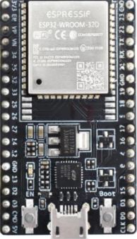
ESP32
ESP32 can perform as a complete standalone system or as a slave device to a host MCU, reducing communication stack overhead on the main application processor. ESP32 can interface with other systems to provide Wi-Fi and Bluetooth functionality through its SPI / SDIO or I2C / UART interfaces.

Slide 6
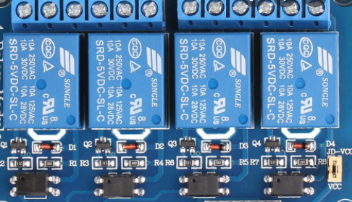
4 Channel Relay Module
The four-channel relay module contains four 5V relays and the associated switching and isolating components, which makes interfacing with a microcontroller or sensor easy with minimum components and connections

Slide 7
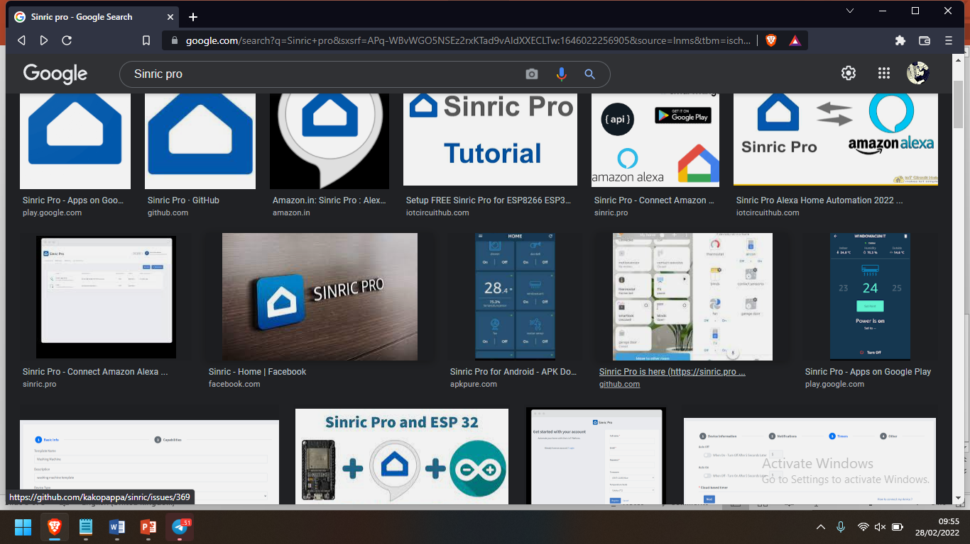
Sinric Pro
With Sinric Pro, you can connect your IOT development board Esp32 to Alexa or Google Home Appilications with a reliable skill - No more glitchy emulation. ... From the Google Home app or dashboard, Install & Enable the "Sinric Pro" Smart Home Skill 4. Create a new device eg: TV. Note the authorization token, signing key, and device-ID for your new device.

Slide 8


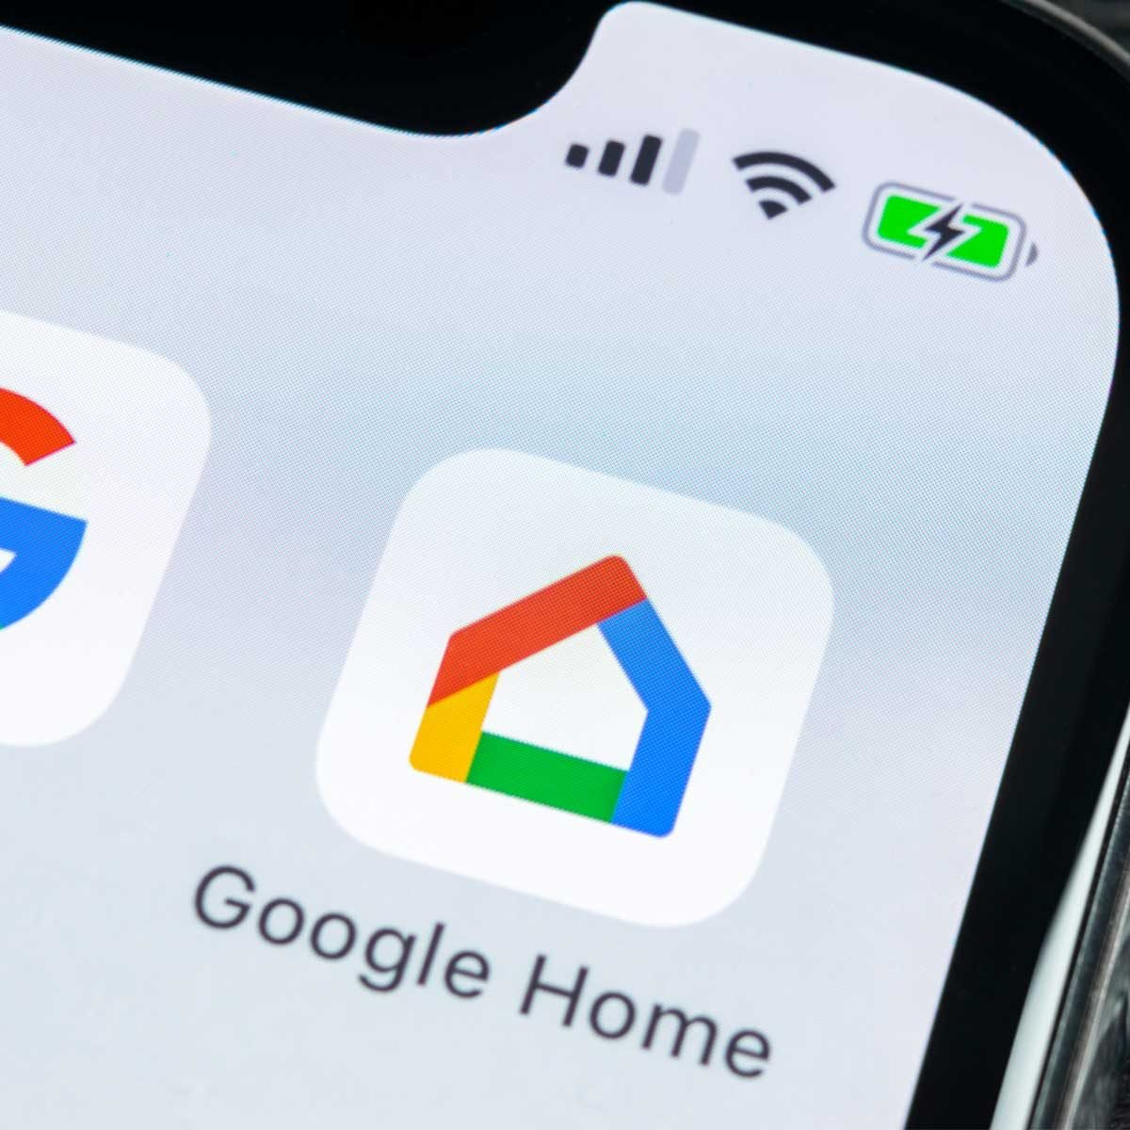
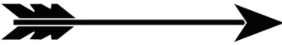
Block Diagram or Work Flow
+

Slide 9
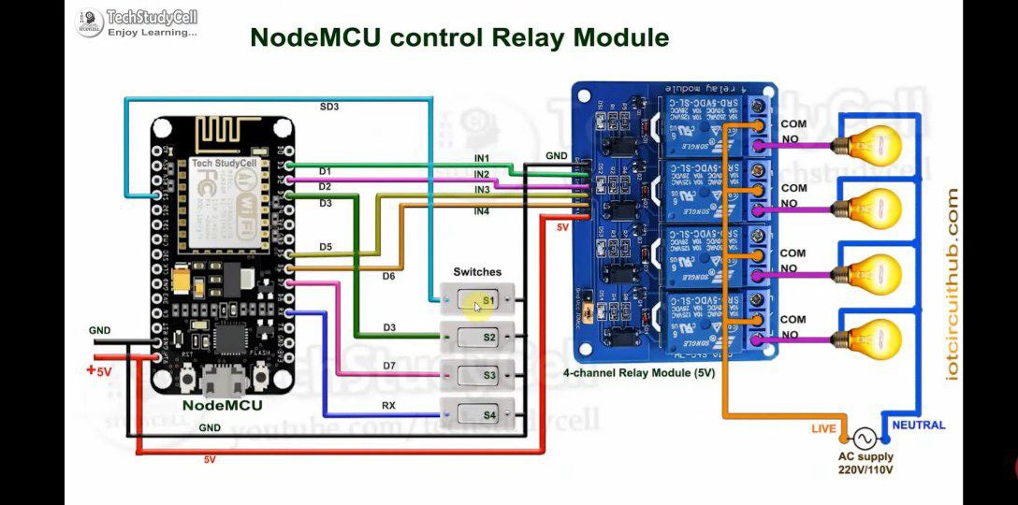
Circuit Diagram

Slide 10
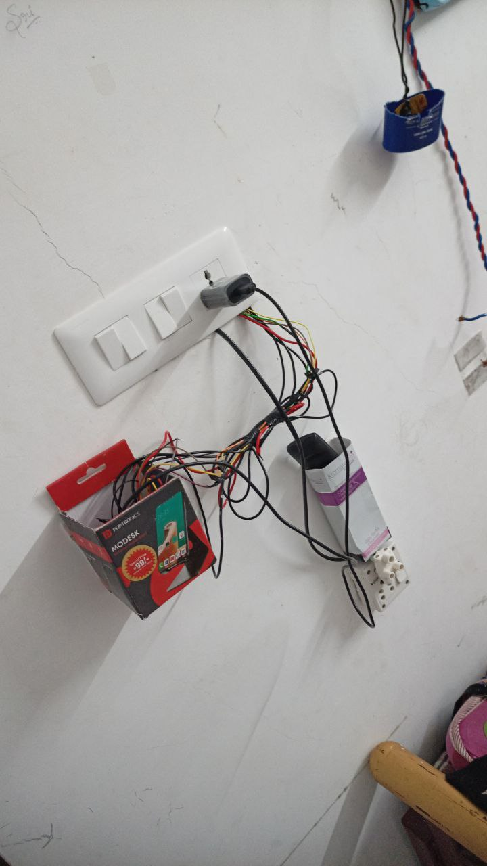
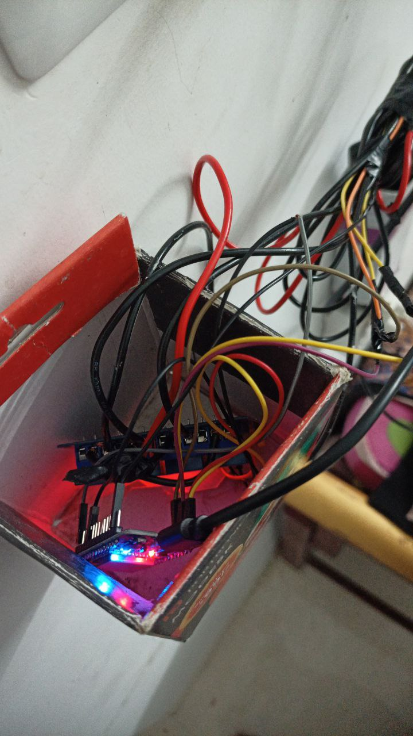
Prototype

Slide 11
Reasons
These smart devices and systems are very important in protecting your home and also transferring information to you instantly.
The information sent to you instantly is sent via your smartphone. IoT based home automation system is the most preferred technological innovation in these years.

Slide 12
THANK YOU..

